Slide 1
Control Statements

Slide 2
Control statement
Control statements in Python are used for managing the flow of execution.
Selection statement/branching statement(if,elif ,nested if)
Iteration statement
Jumping statement(break,continue)

Slide 3
If statement
An if statement is also known as a conditional statement.
A conditional statement takes a specific action based on a check or comparison.
if statement makes a decision based on a condition.
The condition is a Boolean expression. A Boolean expression can only be one of two values – True or False.

Slide 4
If statement
The general syntax for an if statement in Python is the following:
if expression:
#run this code if expression evaluates to True
code statement(s)

Slide 5
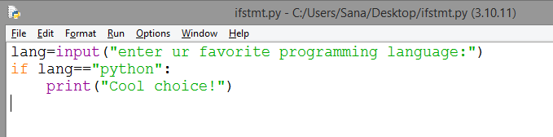
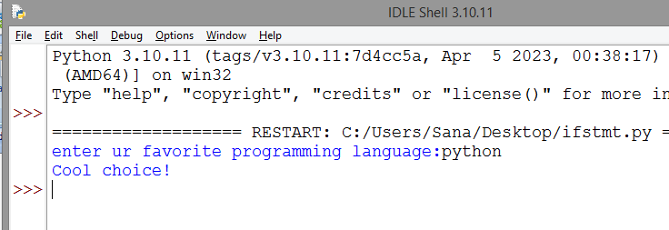

Slide 6
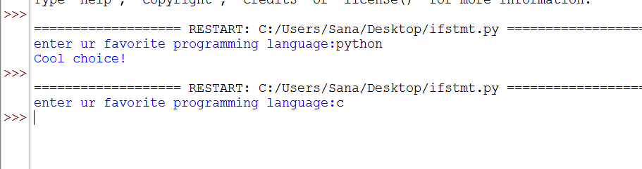
an if statement is usually accompanied by an else statement.
The if else statement essentially says: "if this condition is True do the following thing, else do this thing instead".
The code inside an else statement is the code you want to run if and only if the condition you set in your if statement evaluates to False.

Slide 7
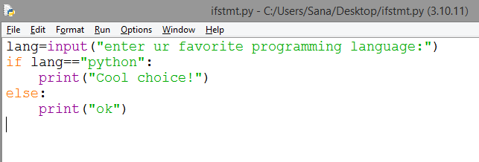
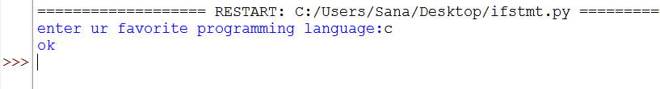
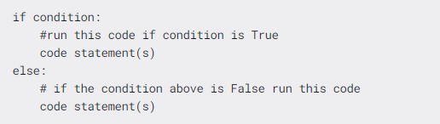

Slide 8
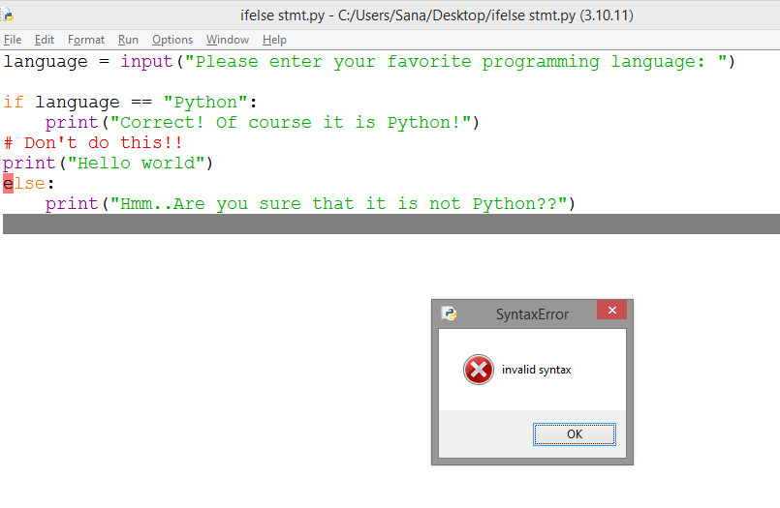
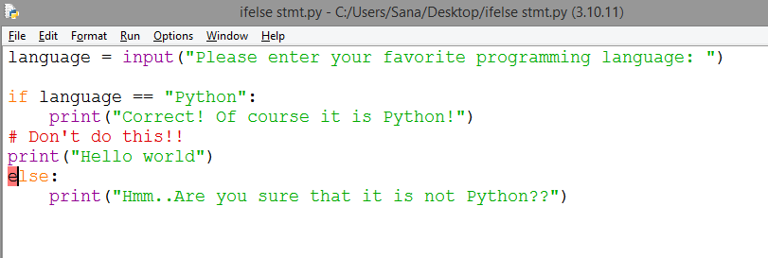

Slide 9
elif statement
to set more conditions and not only have the if and else statements to choose from, you can introduce elif statements.
If the if statement is False Python will move on to the elif statement and try to check the condition set in that block.
You can also write multiple elif blocks, depending on the variety of options you want to have.
An elif statement essentially means: "If this condition is True, do the following. If it isn't, try doing this instead. However, if none of the above is True and all else fails, finally do this."
The general syntax for an elif statement is the following:

Slide 10
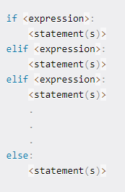

Slide 11
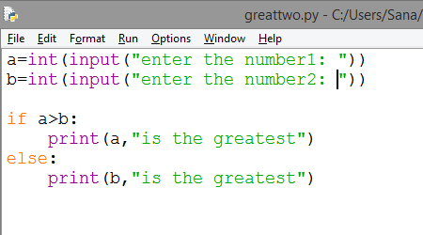


Slide 12
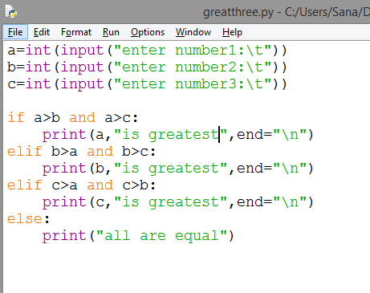

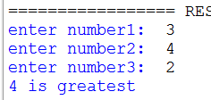
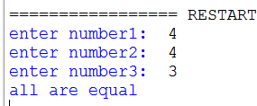

Slide 13
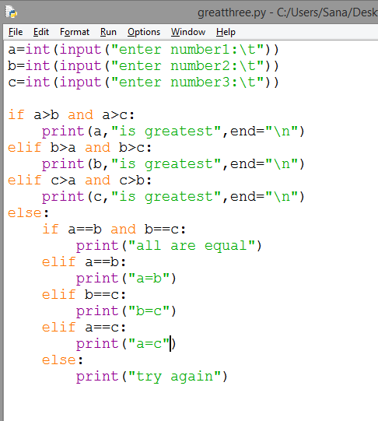
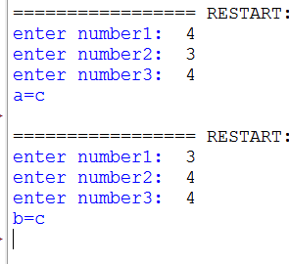

Slide 14
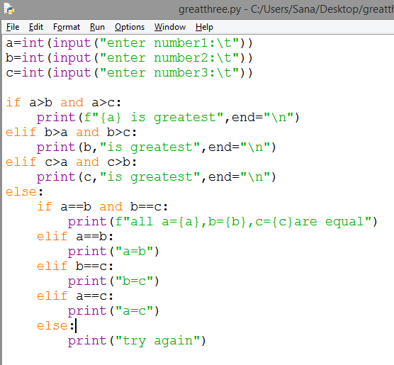


F-strings provide a concise and convenient way to embed python expressions inside string

Slide 15
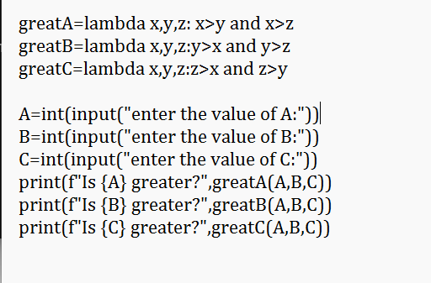
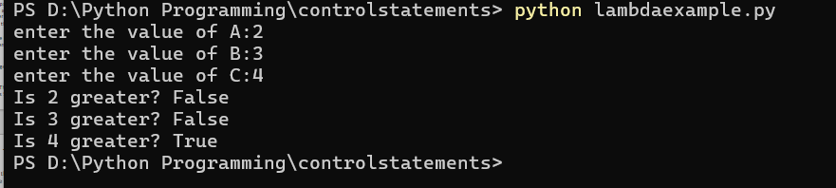

Slide 16
Loops
For Loop
The for loop is used in the case where a programmer needs to execute a part of the code until the given condition is satisfied. The for loop is also called a pre-tested loop. It is best to use for loop if the number of iterations is known in advance.
In Python, there is no C style for loop, i.e., for (i=0; i<n; i++).
Syntax:
for variable in sequence:
statements(s)
Input:
a = 5
for i in range(0, a):
print(i)
Output:
0 1 2 3 4 The for loop runs till the value of i is less than a. As the value of i is 5, the loop ends.

Slide 17
The range() Function
To loop through a set of code a specified number of times, we can use the range() function,
The range() function returns a sequence of numbers, starting from 0 by default, and increments by 1 (by default), and ends at a specified number.
Using the range() function:
for x in range(6): print(x)
Note that range(6) is not the values of 0 to 6, but the values 0 to 5.

Slide 18
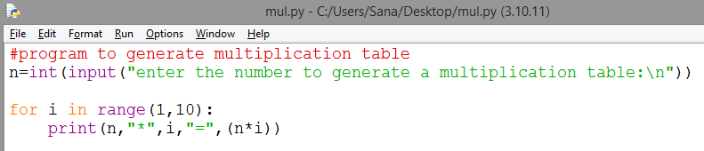
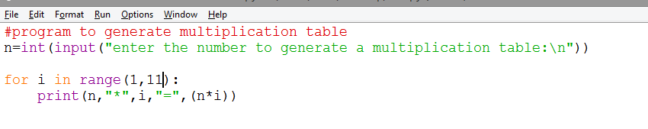

Slide 19
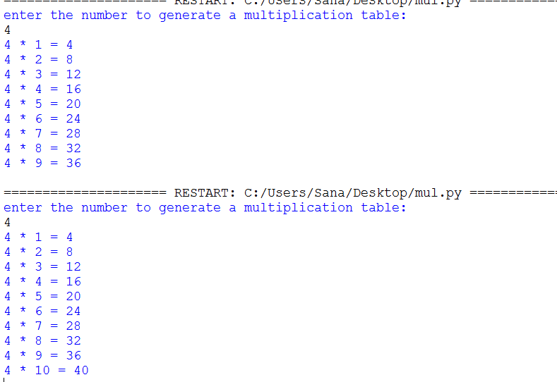

Slide 20
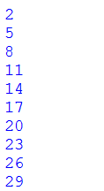
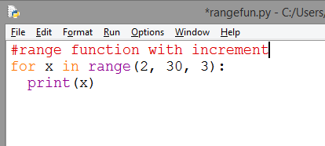
range() function
The range() function defaults to increment the sequence by 1, however it is possible to specify the increment value by adding a third parameter: range(2, 30, 3):

Slide 21
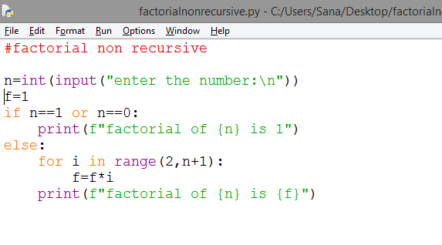
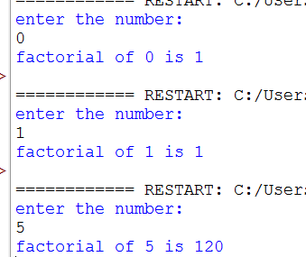

Slide 22
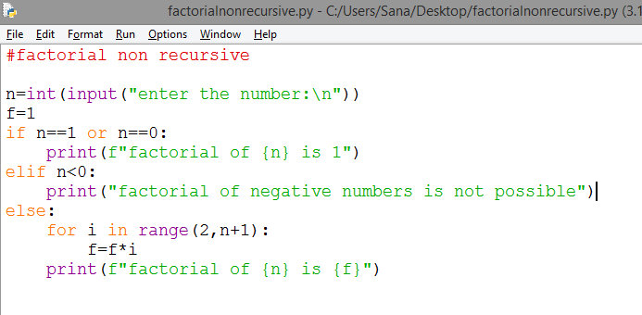

Slide 23
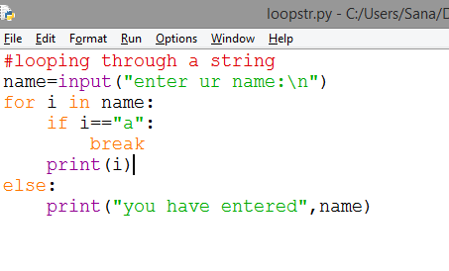
Else in For Loop
The else keyword in a for loop specifies a block of code to be executed when the loop is finished:

Slide 24
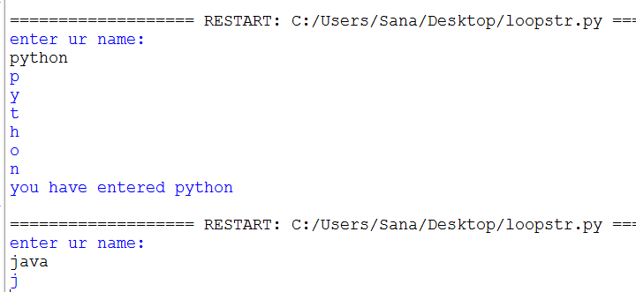

Slide 25
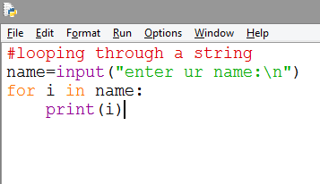
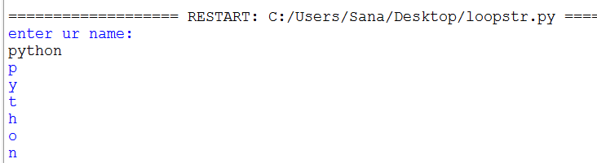
Loop through string

Slide 26
End parameter in python
In Python, end="" is an optional parameter in the print() function that specifies what character or string should be printed at the end of each print statement.
By default, end="\n" is used, which means a newline character is added at the end of each printed item, causing the next print statement to start on a new line.

Slide 27
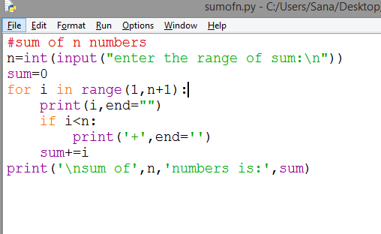
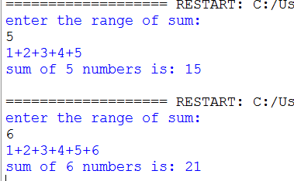

Slide 28
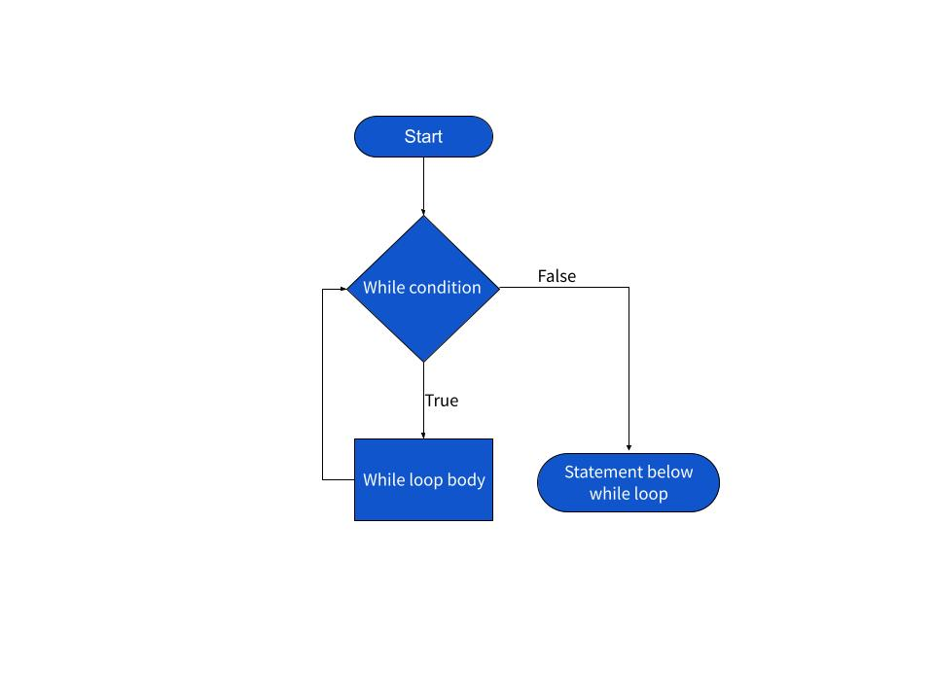
While Loop

Slide 29
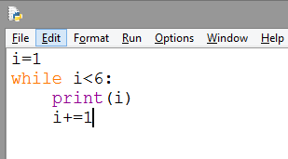
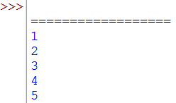
While loop
We can execute set of statements as long as condition is true.

Slide 30
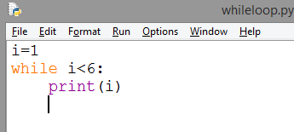
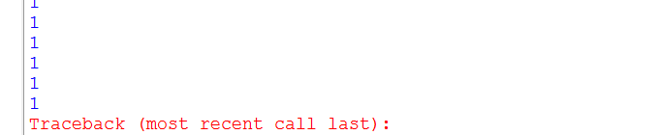
While loop
We can execute set of statements as long as condition is true.
If i is not incremented then loop will execute forever

Slide 31
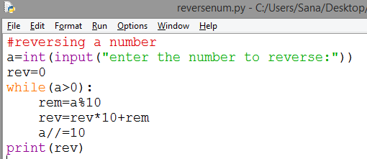
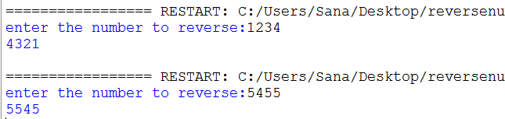

Slide 32
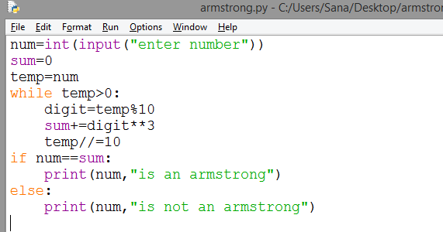
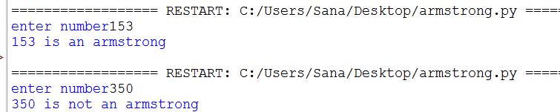

Slide 33
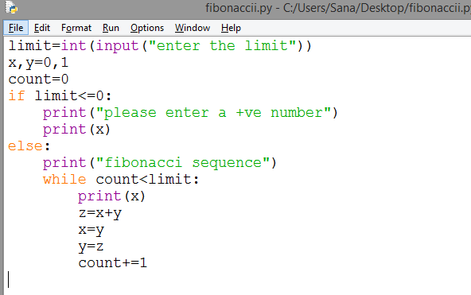
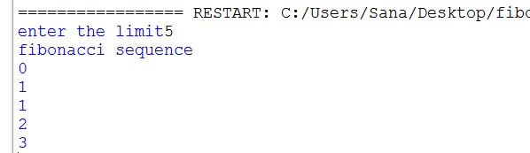

Slide 34
While with else
While statement may have an optional else clause.
while condition:
#stmts
else:
#stmts
The code in else block will execute when the while loop condition is false.

Slide 35
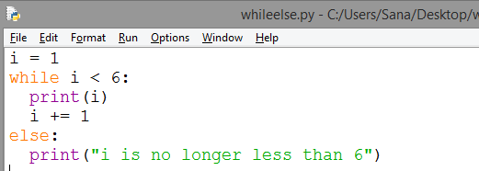
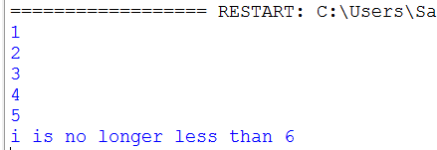

Slide 36
Strings
Strings in python are surrounded by either single quotation marks, or double quotation marks.
'hello' is the same as "hello".
You can display a string literal with the print() function:
print(“hello”)

Slide 37
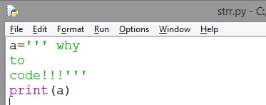

Multiline Strings
You can assign a multiline string to a variable by using three double or single quotes

Slide 38
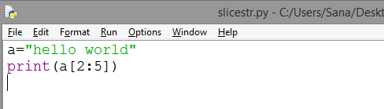
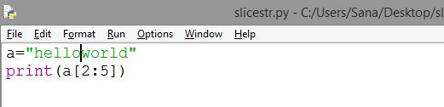
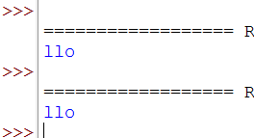
Slicing
You can return a range of characters by using the slice syntax.
Specify the start index and the end index, separated by a colon, to return a part of the string.

Slide 39
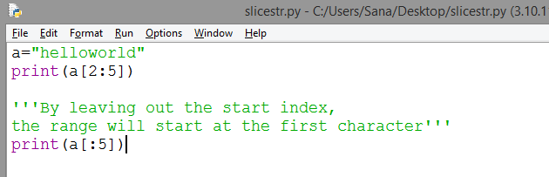


Slide 40

Replace String
Example
The replace() method replaces a string with another string:

Slide 41


Slide 42



Slide 43



Slide 44



Slide 45
Files
Python has several functions for creating, reading, updating, and deleting files.
The open() function takes two parameters; filename, and mode.
There are four different methods (modes) for opening a file:
"r" - Read - Default value. Opens a file for reading, error if the file does not exist
"a" - Append - Opens a file for appending, creates the file if it does not exist
"w" - Write - Opens a file for writing, creates the file if it does not exist
"x" - Create - Creates the specified file, returns an error if the file exists

Slide 46
open()
Syntax
To open a file for reading it is enough to specify the name of the file:
f = open("demofile.txt")
The code above is the same as:
f = open("demofile.txt", "rt")
Because "r" for read, and "t" for text are the default values, you do not need to specify them.

Slide 47




Slide 48



Slide 49



Slide 50




Slide 51


Slide 52


Slide 53


f.close()-closes the file once you're done with all the reading operations.

Slide 54



